Slide 1
Lesson objective
Need whiteboards and calculators
Title: Unitary method
Aim:
Calculate product prices using unitary method
Compare products at random weights
Plan:
Review probability
Costs per 100g review
Unitary method

Slide 2
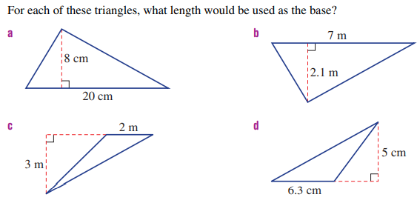
Daily review – calculate area

Slide 3
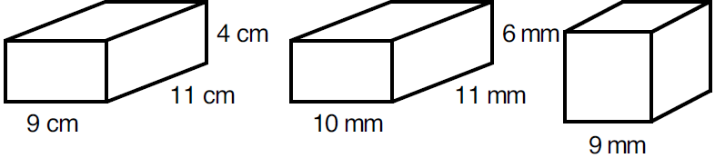
Find the volume of these rectangular prisms?
2
DIAGRAM
RULE
NUMBERS
SOLVE
$$V=b×h×l$$
$$V=9×4×11$$
$$V=396{cm}^{3}$$
$$V=b×h×l$$
$$V=10×6×11$$
$$V=660{mm}^{3}$$
Don’t times them all, just the
Base
Height
Length
$$V=b×h×l$$
$$V=9×9×9$$
$$V=729{mm}^{3}$$

Slide 4
Find the volume of these rectangular prisms?
2
DIAGRAM
RULE
NUMBERS
SOLVE
$$V=b×h×l$$
$$V=b×h×l$$
Don’t times them all, just the
Base
Height
Length

Slide 5
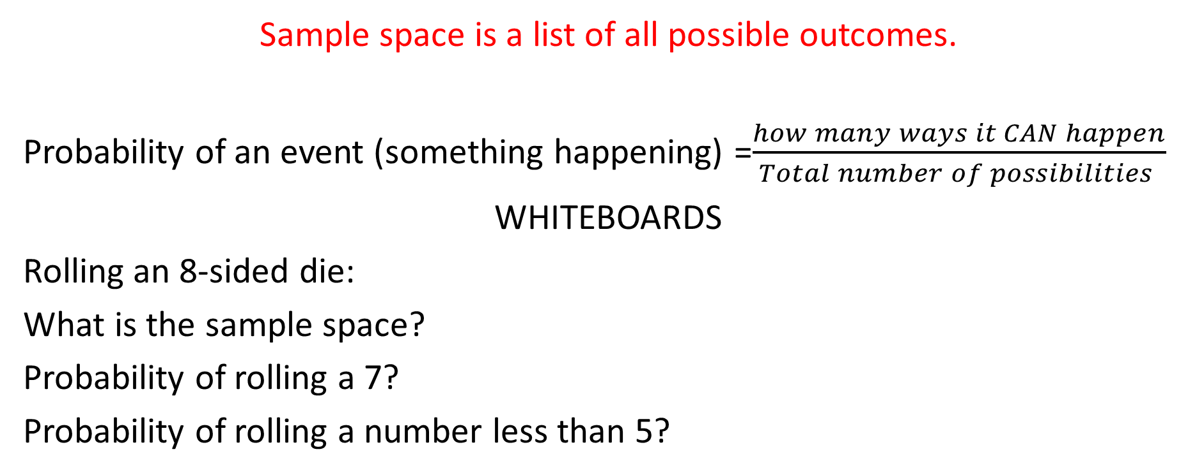
Review probability
Sample space is a list of all possible outcomes.
Probability of an event (something happening) =$\frac{how many ways it CAN happen}{Total number of possibilities }$
WHITEBOARDS
Rolling an 8-sided die:
What is the sample space?
Probability of rolling a 7?
Probability of rolling a number less than 5?

Slide 6
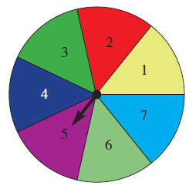
Probability: whiteboards
What is the sample space?
P(green)?
P(red or green)
P(not purple)

Slide 7
Probability expectations
There are 5 marbles in a bag. Blue and yellow are equally likely and there is only 1 red marble.
If we were to do 20 experiments, how many of each colour would we expect to see?
Why did we choose this as distribution?
Colour | Red | Blue | Yellow
Frequency

Slide 8
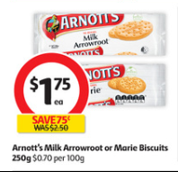
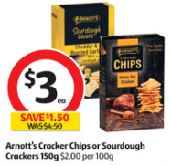
Which item is the best buy?
Option A
Option B

Slide 9
Which option?
You want to buy a new car that costs $8000.
You can wait to save $8000 OR
Pay $300 for 29 weeks.
How much more expensive is option 2?

Slide 10
Cost per 100g revision
Chocolate costs $9.50 for 500g. How much is it for 100g?
Cheese costs $11 for 300g. How much is it per 100g?
Cat food costs $42 for 1400g. How much is it for 100g?

Slide 11
How can we EASILY compare?
Which is the cheaper option and by how much?
100g of chocolate costs $3.20
100g cheese costs $4.50
600g of chocolate cost $20.
400g cheese costs $17.50

Slide 12

Unitary method
Find and write the groups ($$ and Quantity)
$cost ÷quantity$
Answer as a statement per unit

Slide 13

Unit price
Find and write the groups ($$ and Quantity)
$cost ÷quantity$
Answer as a statement per unit
Copy on whiteboards - RECORD
Chocolate costs $12 for 850 grams. What is the cost for 1g

Slide 14
Unit price
Find and write the groups ($$ and Quantity)
$cost ÷quantity$
Answer as a statement per unit
Copy on whiteboards
Cookies cost $15.50 for 650g. How much is 1g?

Slide 15
Unit price
Find and write the groups ($$ and Quantity)
$cost ÷quantity$
Answer as a statement per unit
On whiteboards
200g of chips costs $3.40. How much is 1g?

Slide 16
Unit price
Find and write the groups ($$ and Quantity)
$cost ÷quantity$
Answer as a statement per unit
On whiteboards
A 24 pack of sprite costs $15.60, how much is 1 can?

Slide 17
Unit price
Find and write the groups ($$ and Quantity)
$cost ÷quantity$
Answer as a statement per unit
On whiteboards
1000g of potatoes costs $6.60. How much is 1g?

Slide 18
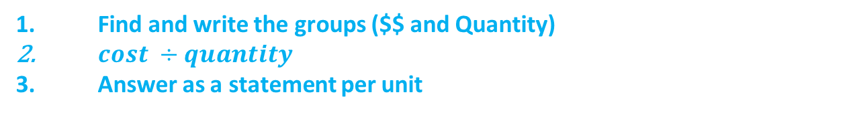
Comparing
Find and write the groups ($$ and Quantity)
$cost ÷quantity$
Answer as a statement per unit
Copy on whiteboards
I do
300g of chocolate for $4.30
550g of chocolate for $6.10

Slide 19
Comparing
Find and write the groups ($$ and Quantity)
$cost ÷quantity$
Answer as a statement per unit
On whiteboards
We do
250g of cheese for $2.30
620g of cheese for $5.15

Slide 20
Comparing
Find and write the groups ($$ and Quantity)
$cost ÷quantity$
Answer as a statement per unit
On whiteboards
you do
310g of vegemite for $5.60
850g of vegemite for $16

Slide 21
Individual task
Complete tasks provided

Slide 22
Fist to five
Aim:
Calculate product prices using unitary method
Compare products at random weights

